Slide 1
APPLICATION OF CLASSIFICATION METHODS
Response Variable: Default Payment (Yes = 1, No = 0)
Explanatory Variables:
X1: Amount of the given credit (NT dollar)
X2: Gender (1 = male; 2 = female).
X3: Education (1 = graduate school; 2 = university; 3 = high school; 4 = others).
X4: Marital status (1 = married; 2 = single; 3 = others).
X5: Age (year).
X6 - X11: History of past payment - repayment status of past monthly payment records
X12-X17: Amount of bill statement (NT dollar) – by month
X18-X23: Amount of previous payment (NT dollar) – by month
Exploratory Data Analysis
Dimension Reduction
Logistic Regression
Random Forest Classifier
Support Vector Machines
AdaBoosting

Slide 2
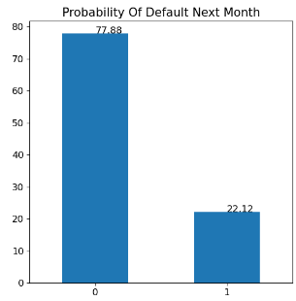
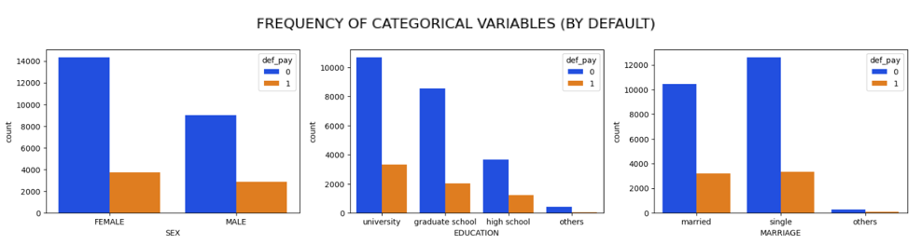
EXPLORATORY DATA ANALYSIS
Total: 30,000 observations for all 25 variables
(No missing observations):
Frequency of Categorical variables (by default):
23,364 out of 30,000 observations were in the default = 0 category

Slide 3
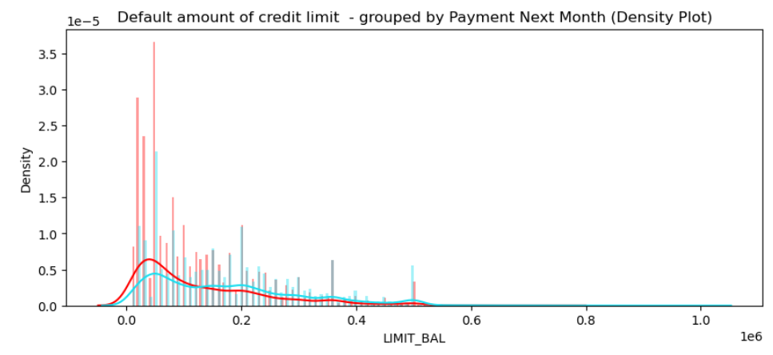
EXPLORATORY DATA ANALYSIS
Key Observation:
Most defaults happen for credit limits in the range of 0 – 100,000.

Slide 4
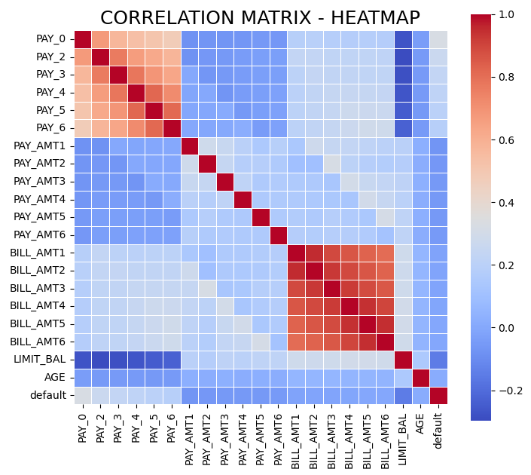
EXPLORATORY DATA ANALYSIS
Key Observations:
Variables that measure the same construct (repayment status and bill amounts) in different time periods exhibit a high correlation.
Correlation decreases with distance between months.
No correlation between amounts of previous payments for April-Sept 2005.

Slide 5
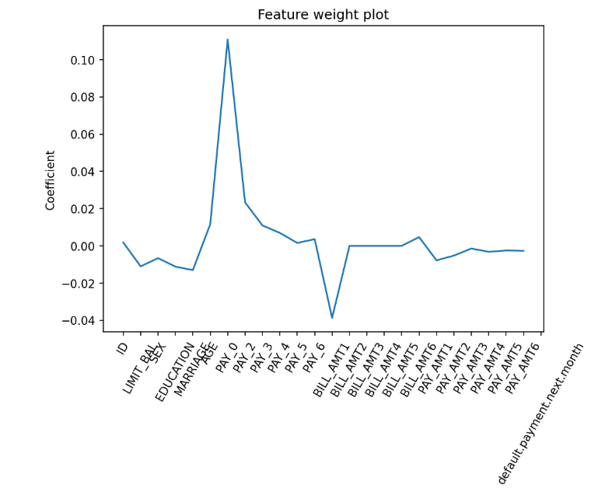
DIMENSION REDUCTION
Standardization: to ensure that all variables are on the same scale
Training-Test Data Split: randomly in the ratio of 75:25.
FEATURE SELECTION USING LASSO REGRESSION:
Five-fold cross validation
Tuning parameter: 0.0010608
4 of the coefficients were exactly zero:
'BILL_AMT2', 'BILL_AMT3', 'BILL_AMT4', 'BILL_AMT5’
(dropped from the model)

Slide 6
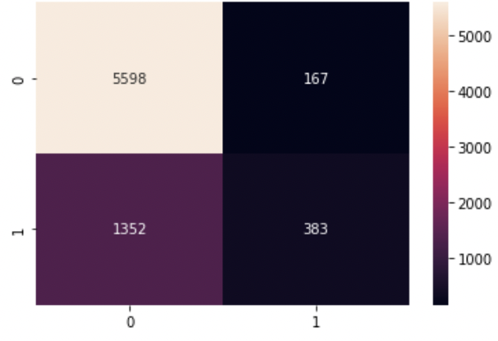
LOGISTIC REGRESSION
models the probability that default belongs to a particular category
Inverse of regularization strength (C): 0.9541
Score for best logistic regression model = 0.813156
Accuracy = 79.75%
Error Rate= 20.25%
Precision = 69.636%
F1 score = 33.52%
Computing Time: 0.0909 s
CONFUSION MATRIX

Slide 7
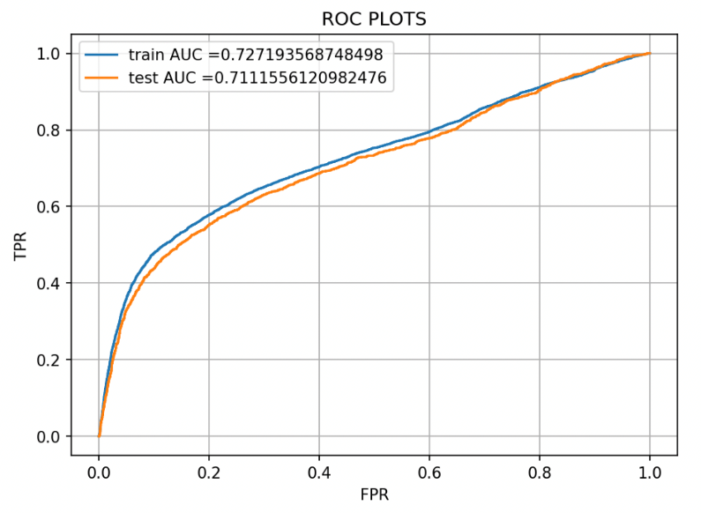
LOGISTIC REGRESSION

Slide 8
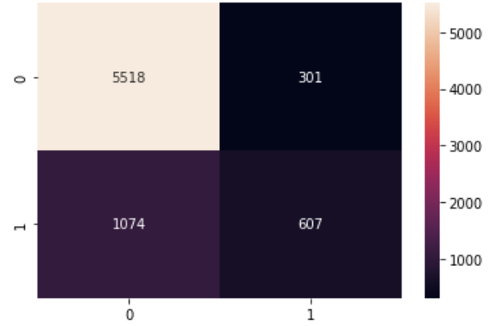
RANDOM FOREST CLASSIFICATION
decorrelates the trees by forcing each split to consider only a subset of the predictors
Bootstrap = True
Criterion = Gini
Maximum Tree Depth = 6
Maximum Features = Auto
# Estimators = 700
Score for best random forest classifier = 0.823066
Accuracy = 81.67%
Error Rate= 18.33%
Precision= 66.85%
F1 score= 46.89%
Computing Time: 25.6793 s
CONFUSION MATRIX

Slide 9
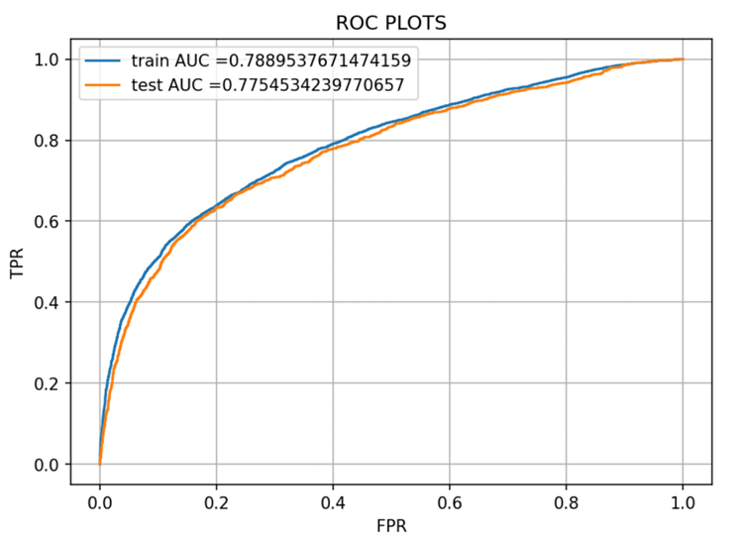
RANDOM FOREST CLASSIFICATION

Slide 10
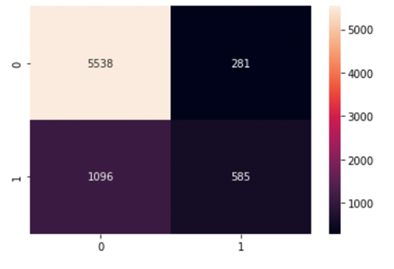
SUPPORT VECTOR MACHINES
Identifies a linearly separable hyperplane, or a decision boundary separating members of one class from the other
Regularization Parameter, C= 2
Kernel Coefficient, gamma = 0.03166227766
Accuracy = 81.64%
Error Rate= 18.36%
Precision= 67.55%
F1 score= 45.94%
Computing Time: 30.44 sec
CONFUSION MATRIX

Slide 11
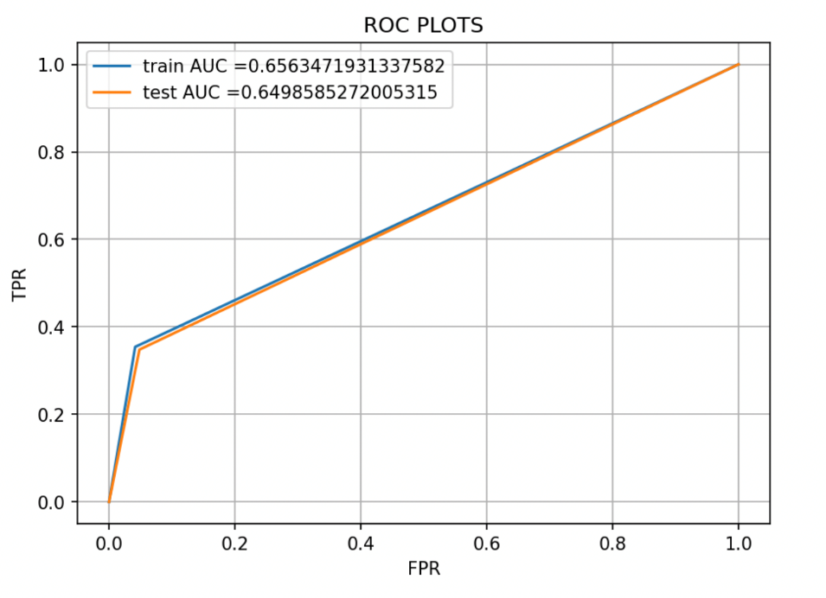
SUPPORT VECTOR MACHINES

Slide 12
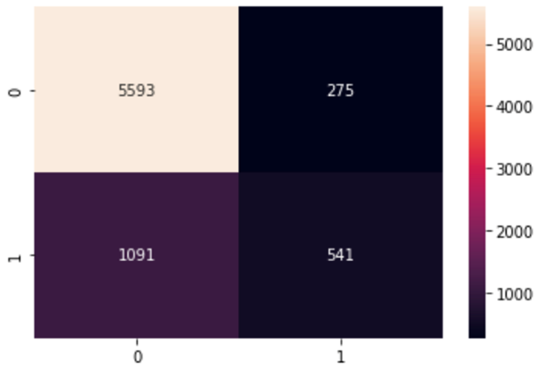
AdaBoosting
each tree is grown using information from previously grown tree
Learning Rate: 1
#Estimators: 100
Score for best Ada Boosting model = 0.8184
Accuracy = 81.79%
Error Rate= 18.21%
Precision= 66.299%
F1 score= 44.199% Computing Time: 3.267 sec
CONFUSION MATRIX

Slide 13
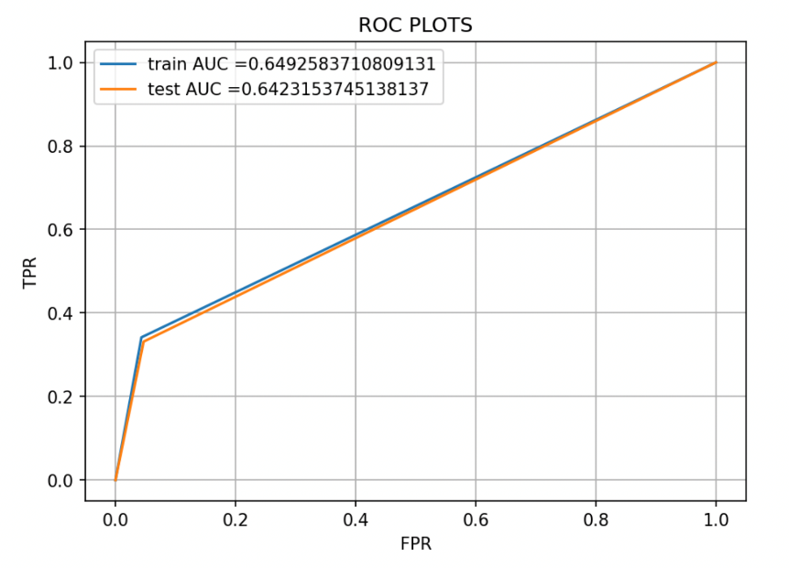
AdaBoosting

Slide 14
SUMMARY
 | Logistic Regression | Random Forest Classifier | Support Vector Machine | AdaBoosting
Best Model Parameters | C= 0.9541 | Bootstrap = True Criterion = Gini MaxTree Depth = 6 MaxFeatures = Auto # Estimators = 700 | C=2 gamma = 0.03167 | Learning Rate: 1 #Estimators: 100
Accuracy | 79.75% | 81.67% | 81.64% | 81.79%
Error Rate | 20.25% | 18.33% | 18.36% | 18.21%
Precision | 69.63% | 66.85% | 67.55% | 66.29%
F1 score | 33.52% | 46.89% | 45.94% | 44.199%
Computing Time | 0.0909 seconds | 25.6793 seconds | 30.44 seconds | 3.267 seconds

Slide 15
Logistic Regression
Random Forest
SVM
Ada Boosting

